Slide 1
Evolution
Is fundamentally, a genetic process
Written in the genetic code of species alive today
Story of life on earth is the story of the molecule of life---DNA---and the various ways in which it manifests itself, in the form of living species in order to survive

Slide 2
Evolutionary Processes
Processes that produce, maintain or redistribute variation in a population
Recombination (sexual reproduction)
Natural selection
Mutation
Gene Flow
Genetic Drift

Slide 3
Natural Selection
Sorts out certain variations
Favorable traits increase while unfavorable traits decrease in the population
The environment (nature) determines which traits are favorable
Example: Peppered Moths of England

Slide 4
Important Points of Moth Example
Trait must be inheritable (passed on to succeeding generations)
Through sexual reproduction
Variation must already exist
Two varieties of moths (spotted & dark gray)
Importance of reproductive success (“survival of the fittest”)
Moths w/advantageous coloring survived predation, reproduced & passed on their genes for coloring, which affected the composition of the population
Adaptation = resulting from natural selection; ability of a population to survive & reproduce w/in their environment

Slide 5
Natural Selection
Selection is a process by which genes that produce better adaptations become more frequent over time
Does NOT always lead to production of new species

Slide 6
What is a species?
A group of interbreeding populations that is reproductively isolated from other such groups
Speciation = the production of new species

Slide 7
What causes speciation?
Reproductive isolating mechanisms = barriers that prevent interbreeding
Can be physical or behavioral (example: Galapagos finches)
http://media.pearsoncmg.com/ph/hss/shared_hss_assets/anthropology/mal_animations/new/animations/05_02t.html
Can be pre-mating or post-mating barrier
Continued adaptation to specific environmental conditions

Slide 8
The Pace of Evolution
Natural Selection is a gradual process
Different characteristics evolve at different rates (mosaic evolution); produces transitional forms

Slide 9
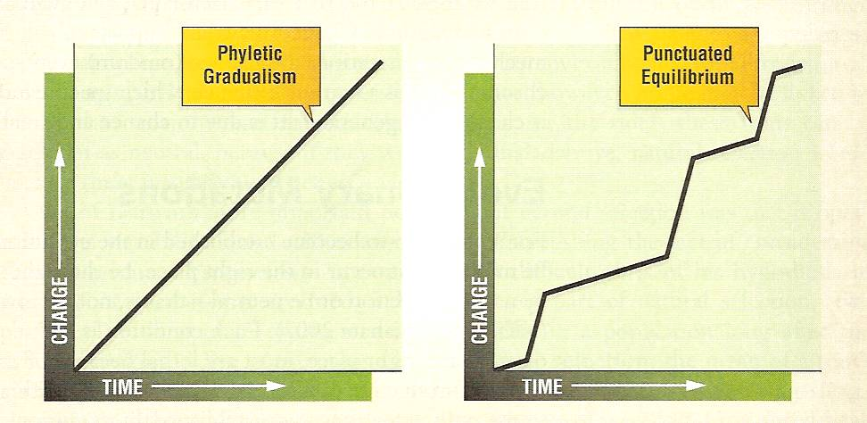
Punctuated Equilibrium
Occurs when species tend to remain stable or change little through time
Big changes occur in relatively short periods of time

Slide 10
Evolutionary Radiation
Many distinct lineages diverge from a common ancestor within a short time
Occur w/evolution of a new adaptation that provides access to new resources or a new way of life, or when other species become extinct; occupation of new ecological niches

Slide 11
Mutation
A mistake or error in the copying process during cell division and DNA replication
Not always harmful; may be neutral or beneficial (ex: Lactase persistence)
Is the only source of NEW variation

Slide 12
Importance of Mutations, cont.
Different types of genes that control phenotype: Structural and Control Genes
Control genes – act as “master switches” that turn strings of structural genes on and off
Can radically alter body plan/function
Can show up in a single generation
Coupled w/environmental change (epigenetic), can lead to dramatic evolutionary changes
Evolving switches

Slide 13
Definition of Evolution
A change in gene frequency (or the frequency of alleles) in a population over time

Slide 14
How do allele frequencies change?
Sexual selection
Gene flow
Genetic drift

Slide 15
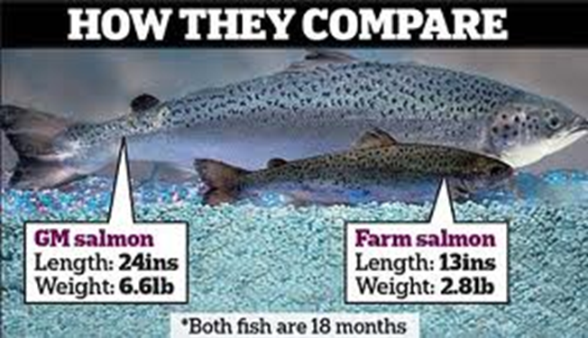
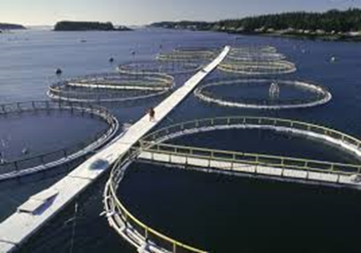
Sexual selection
Female preference for species specific traits or behaviors that influence mate selection and gene frequency
Example: “Super Salmon vs. Wild Salmon”

Slide 16
Gene Flow
Exchange of genes between populations through interbreeding

Slide 17
Gene Flow
80% Blue Butterflies
50% Blue 50% Orange
40% Blue Butterflies

Slide 18
Genetic drift
Random splitting of a population (Fission)
New population has different allele frequencies from that of the original population
Founder Effect – creates concentration of alleles (genetic bottleneck)
http://media.pearsoncmg.com/ph/hss/shared_hss_assets/anthropology/mal_animations/new/animations/05_05.html

Slide 19
Genetic Drift
33% Orange
50% Blue 50% Orange
67% Orange

Slide 20
In Sum
Evolution is a process
The production and redistribution of variation (inherited differences between individuals)
Recombination, gene flow and genetic drift “reshuffle” the genetic variation
Mutations create new genotypes & phenotypes
Natural selection acts on these sources of variation (differences between individuals)

Slide 21
Cancer’s Wandering Gene: Examples of Gene Flow, Genetic Drift & Mutation
How did the BRCA-1 gene arrive in the New World?
Mutation originated 2,500 years ago. “Founder” came from a population of Sephardic Jews in Spain who converted to Catholicism & migrated to New World, linking Hispanic population in New Mexico & Colorado to Jewish ancestry
What does the BRCA-1 gene ordinarily do?
It is a tumor suppressor gene
What was the mutation that happened?
A missing A & G (chemical bases of DNA molecule) on ONE copy of the chromosome
Why did the “founder” who had the mutation survive?
Founder was protected by the working copy of the gene
Why is the BRCA-1 gene so deadly?
It is a dominant allele
The dominant copy will override the healthy allele at some point
Most common & deadly single-gene disease identified in any population

Slide 22
Cancer’s Wandering Gene
How does the practice of endogamy (marrying within one’s cultural/religious group) contribute to the concentration of Tay-Sachs among the Ashkenazim Jewish population?
There are more possibilities for carriers of the Tay-Sachs gene to pass on the allele to offspring
How are the rabbis attempting to reduce the occurrence of Tay-Sachs disease?
Encouraging engaged couples to undergo genetic testing and counseling so they can decide whether or not to MARRY or to HAVE CHILDREN

