Slide 1
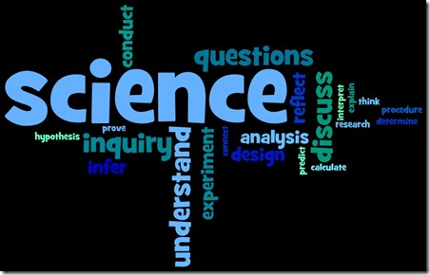
Science, Evolution, and Creationism
“Much learning does not teach understanding”
– Heraclitus, Greek philosopher
(ca. 535-475 BCE)

Slide 2
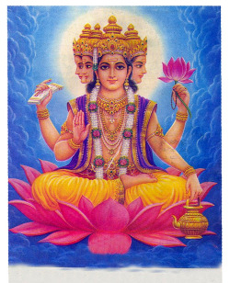
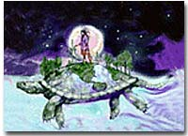
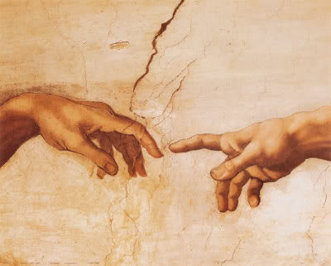
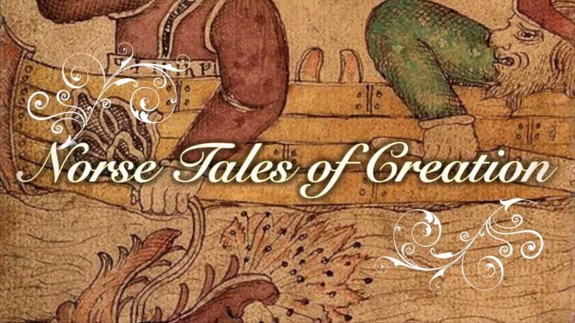
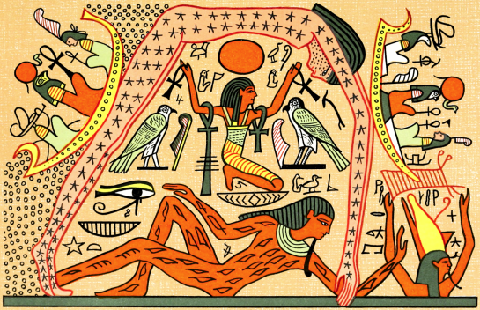
The Search for Meaning & Understanding
All cultures have their own creation story
Belief that the world & everything in it was created by a creator
(Creator = “God”, divine being(s), intelligent agent, etc.)
= Creationism

Slide 3
What Does“Supernatural” Mean?
Events or phenomena that are not part of the physical/material/natural world
Makes them untestable; no way to validate or invalidate

Slide 4
Four Types of Evolution
Evolution of the solar system (cosmic evolution)
Evolution of life on earth
Evolution of various biological species from different ancestral species
Evolution of culture

Slide 5
What is Evolution?
Change in living things over time
Verb – the process of change through adaptation and selection
Noun –
An explanation for how this change occurs
An idea that recognizes that change is constantly occurring
Humans, other living things, the planet and the cosmos are part of an ongoing developmental process

Slide 6
Misconception One:
Evolution is a theory about the origin of life
Biological continuity – all life comes from life
Evolution explains how life that already exists, evolves (changes)
Evolution provides evidence of this change
Supported by a “convergence of evidence” from genetics, geology, anatomy, animal behavior, paleontology
Must demonstrate that the evidence is wrong, or that it fits another theory better

Slide 7
It’s “not just a theory” so what is a theory?
It is NOT a guess
In scientific use, it is a generally accepted explanation supported by empirical evidence (incorporating facts, laws, principles, and tested hypotheses)
Fact = confirmed observation
Law = states what will happen under certain circumstances
Theories explain laws and facts
Theories can and do change

Slide 8
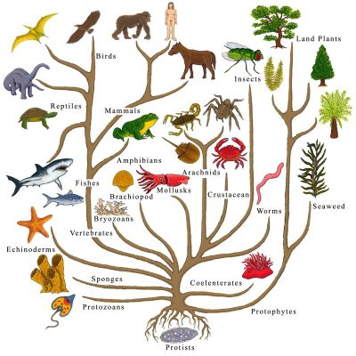
Misconception Two:
Humans evolved from apes
Evolution says all living things are related (DNA)
Biological continuity – descent with modification (confirmed by the chemistry of life - molecular biology)
Evolution says we shared a common ancestor with apes (chimps in particular)

Slide 9
Apes
Humans
m o y
m o y
Common Ancestor
7-8 million years ago

Slide 10
Misconception Three:
Context
please…
Evolution and Creationism are competing theories about human origins so,
Students should be taught “both sides” aka “The Equal Time” Argument
Why is this problematic?
Definition of a theory
The supernatural element (of creation stories)
Assumes there are only two sides
Only advocating for Christian/Biblical version of creationism

Slide 11
The First Amendment of the U.S. Constitution
“Congress shall make no law respecting the establishment of religion, nor inhibiting the free exercise thereof.”
The separation of church and state ensures that no singular religion is forced on any individual in a public institution

Slide 12
Theory of Evolution as a Scientific Explanation
Based on the scientific method
Answers the questions of who and what we are as a biological species
Based on conclusions drawn from the scientifically revealed universe

Slide 13
The Scientific Method of Problem Solving
Begins with empirical observations of the natural world (empirical = based on experience)
Asks a question about a natural phenomenon
Makes testable hypotheses that can be validated or invalidated through experimentation
Aim is to develop answers or improve explanations for observations or events in the natural world based on evidence
“Science is part of the reality of living; it is the what, the how and the why of everything in our experience”
–Rachel Carson, Biologist & Conservationist

Slide 14
Hypotheses
Are statements of or predictions about the relationship among things,
Often take the form of “if…then…” statements
Example: If humans and apes share a common ancestor, then we would expect to find the earliest fossils of our ancestors where apes evolved and live---in Africa

Slide 15
Hypothesis to Theory
Tested hypotheses help build reliable and accurate explanations (theories)
Removes incorrect approaches & encourages the further testing of productive ones
For a hypothesis to become a theory it must:
Be extensively tested (& repeatable)
Be supported over time
Explain a broad range of facts
Have a high degree of reliability

Slide 16
The nature of scientific explanations
Based on empirical observations & experiments
Based on evidence
Historical
Limited to knowledge/info available at a specific point in time
Cumulative– build on previous ideas, observations, and experiments
Limited - by technology, methods, and to natural phenomena
Subject to modification
Can accommodate new info/discoveries

Slide 17
Theory of Evolution as a Scientific Explanation
Makes a set of predictions that can be tested and verified
If…then stmts.
Presents a consistent set of conclusions using a convergence of evidence

Slide 18
What makes Creationism Unscientific?
Creation stories, and the creation event itself, are “supernatural”; they are not part of the physical, natural world
They are untestable; cannot prove or disprove whether or not “creation” happened, or whether or not there is a “creator”
Belief in Creationism relies solely on Faith (rather than evidence)

Slide 19
Critical Thinking
Requires us to critically examine our assumptions and our own worldviews
Worldview – an interpretive framework for making sense of the world
Set of convictions about the nature of what is true, real & important
Is constructed & taken for granted

Slide 20
Towards an Evolutionary Worldview
Key insight is that the world is constantly changing
“The only thing that never changes is change”
Can be applied to an understanding of ALL domains of human life & experience:
economics, politics, culture & consciousness
Requires us to be synthesizers; to be holistic
Helps us to understand who we are, how we got here and what our role is in creating a more just, humane, peaceful & sustainable world & future

