Slide 1
Two Questions Darwin Could Not Answer
What was the source of variation?
Where do these traits (distinguishing physical/behavioral characteristics) come from?

Slide 2
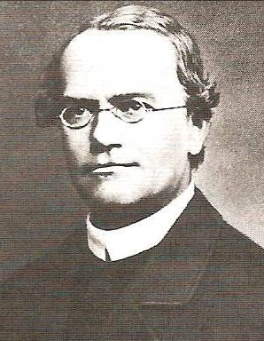
Gregor Mendel
Austrian monk who experimented
with garden pea plants
Produced hybrids = offspring of mixed ancestry
Carefully selected plants that came in only two varieties (either tall or short; either white or red flowers; either yellow or green seeds – no intermediate forms)

Slide 3
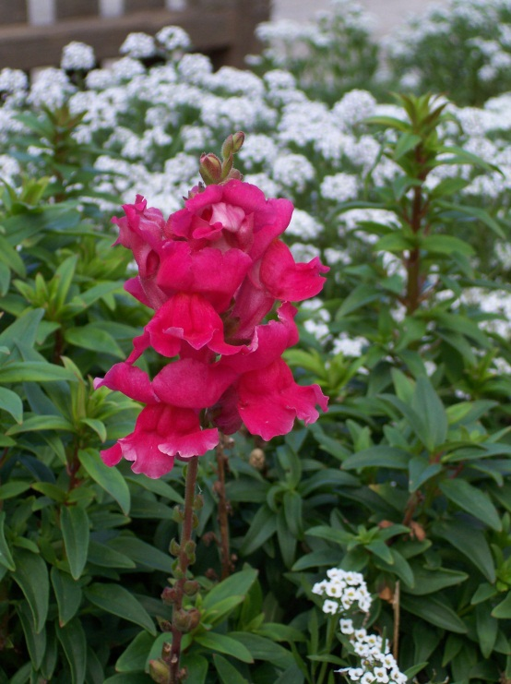
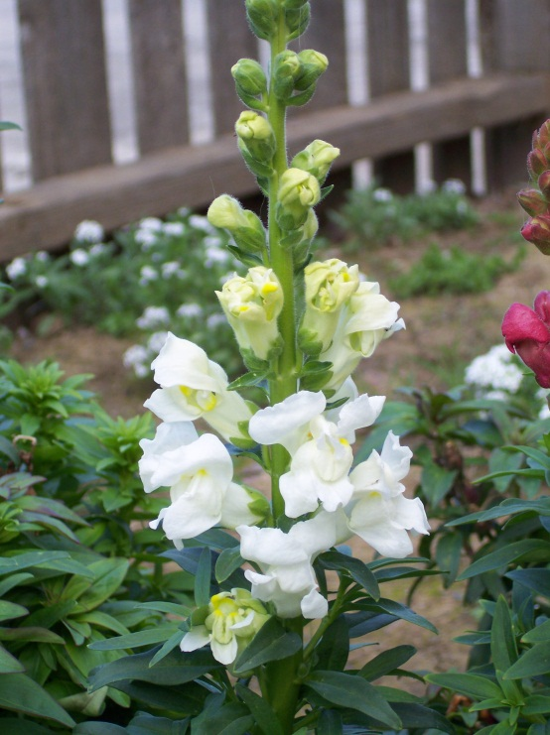
1st generation
2nd generation

Slide 4
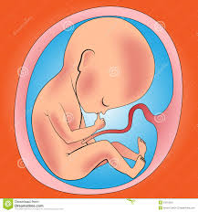
Mendel’s Observations of The Basic Laws of Inheritance
Appearance of specific traits is determined by
Inheritance of genes passed on from mom & dad
ll II
Individual inherits one gene from each parent for each trait (2 genes per trait)
II

Slide 5
Laws of Inheritance, Cont.
Particular variation of a trait may not show up in each generation; may show up in later generations
Genes may come in different versions called alleles = different form of same gene
Example: civics/accords are different forms of Honda
Some alleles are dominant (meaning they show up, i.e., expressed, in the physical form/appearance = phenotype)
Other alleles are recessive (meaning they aren’t necessarily visible in the outward appearance, but still present in the gene)

Slide 6
Laws of Inheritance, Cont.
When a dominant & recessive allele are paired together, the dominant form is expressed, the recessive is hidden
These traits are monogenic = meaning the trait is controlled by a single gene
Appear in either/or variation
These are traits of simple inheritance

Slide 7
Trait = Flower Color
Two variations:
Gene = Rr (two alleles)
R = dominant (red) r = recessive (white)
Genotype: (combination of alleles) Phenotype (physical trait)
- in this case, flower color
RR = homozygous dominant
Rr = heterozygous dominant
rr = homozygous recessive

Slide 8
with
RR
rr
1st generation
Rr
Rr
Rr
Rr
Rr x Rr
2nd generation
Rr
RR
Rr
rr
rr

Slide 9
Traits in humans
Most are polygenic = controlled or determined by multiple genes
Produces great range of variation (differences in the phenotypes)
Examples: Eye color, skin color, hair color, height

Slide 10
“Flower Children”
Leaf Shape
Broad
Narrow
Petal Shape
Round
Oblong

Slide 11
How Genes Work
What exactly is a gene?
Where is this genetic information that is being passed down stored or located?
How does genetic variation occur?

Slide 12
What are Genes?
Stretches of DNA molecules that carry the instructions for building a living thing
DNA as “blue print”

Slide 13
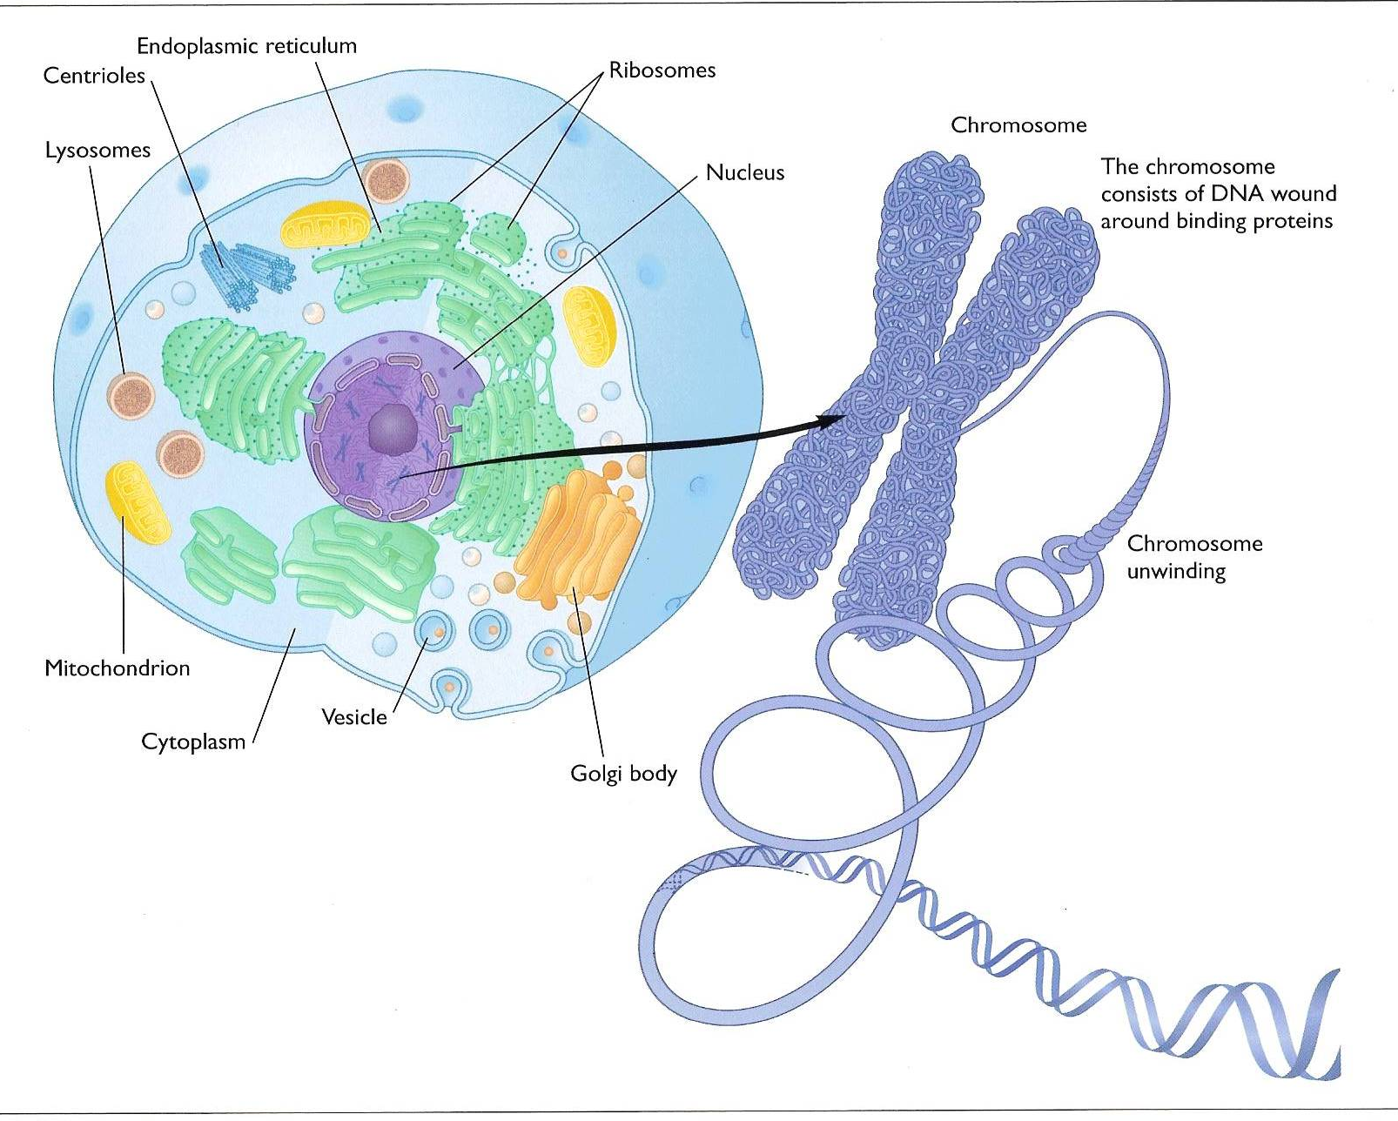
Where are Genes located?
Stored on the chromosomes
Chromosomes are:
Coiled strands of DNA molecules
Carry genetic info & instructions to carry out genetic/cellular activity
Found in the nucleus of the cell

Slide 14
DNA Functions
Direct protein synthesis
Must specify the make up of proteins
Replication
Must make copies of itself to be passed down from generation to generation

Slide 15
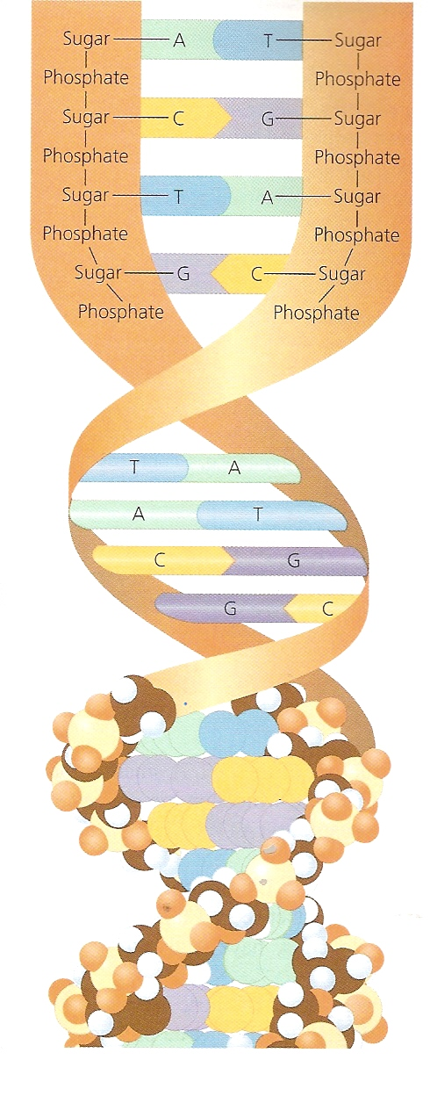
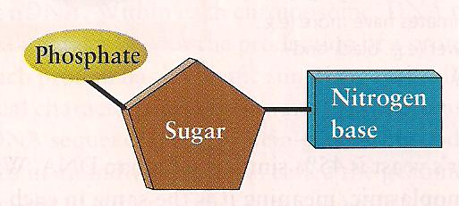
DNA Molecule: Structure
Made up of four
chemical bases:
Adenine (A)
Thymine (T)
Cytosine (C)
Guanine (G)

Slide 16
Function of DNA: Making Proteins
Bases group together to form a codon
Each codon (word) creates a specific amino acid

Slide 17
Making Proteins, Cont.
A string of amino acids (sentence) makes a specific protein
Proteins determine what an organism will look like

Slide 18
Function of DNA: Replication
To be passed down generation to generation, each cell must contain ALL genetic info to build & maintain cells

Slide 19
DNA Replication
Splits in half at base pairs
A – T (Adenine – Thymine)
C – G (Cytosine – Cytosine)
Rebuilds the other side

Slide 20
Mitosis
Division & replication of somatic (regular) cells (Ex: skin cells, bone cells)
Somatic cells are diploid (contain 2 chromosomes)
46
46
46
46
46
46
46

Slide 21
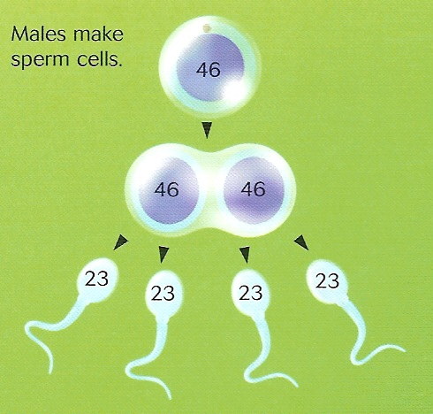
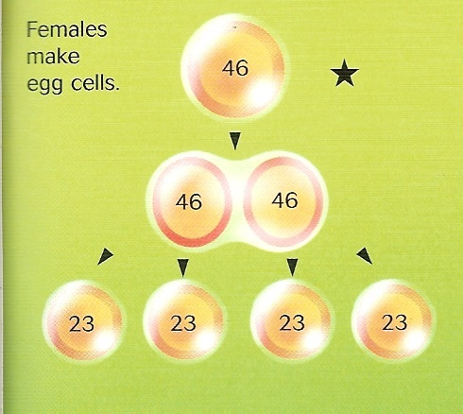
Meiosis
Production of reproductive cells (gametes)
Sperm in males; Eggs in females
Gametes are haploid (have only 1 chromosome; i.e. contain half of individual’s genetic info)

Slide 22
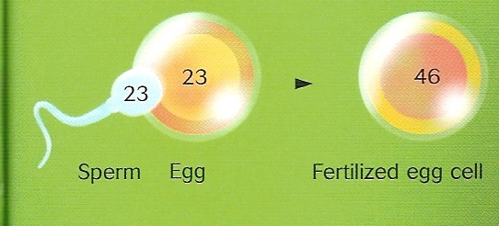
Recombination
New genetic combinations as a result of sexual reproduction = VARIATION

Slide 23
The Epigenome & Epigenetics
New understandings of DNA, gene function & gene expression
A lot more variables involved in getting from genotype to phenotype
Variation in genes themselves:
Structural genes (build the proteins directed by DNA) and Control genes
Genes part of more flexible network
Position of chromosomes in nucleus affect gene activity & expression
Genes respond to conditions/experiences in our lives
Flexibility = survival

Slide 24
The Epigenome
Means “above or upon” the genes
DNA is wrapped around histones
To be activated, gene must be unwound from histones
Different experiences bring new chemicals into the cell which change chemical environment
Chemical markers act as “on/off switches”
Genes need instructions for what to do & where & when to do it
Changes gene expression/activity, but not the DNA itself
The Epigenome

Slide 25
Lessons from the Epigenome
Genes have a lot more flexibility (ability to be altered for good or bad) than previously thought
This flexibility responds directly to environmental inputs
Based on people’s experiences
Stress, exposure to toxic chemicals, diet, etc
DO occur during an individual’s lifetime and may affect offspring & future generations
“Epigenetics is proving we have some responsibility for the integrity of our genome”
That is, our genes change our lives and our lives change our genes…

